Slide 1
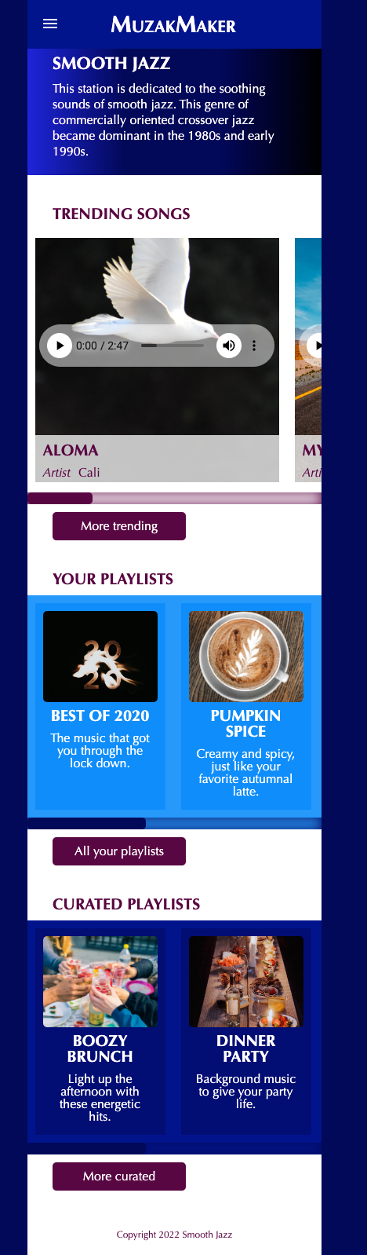
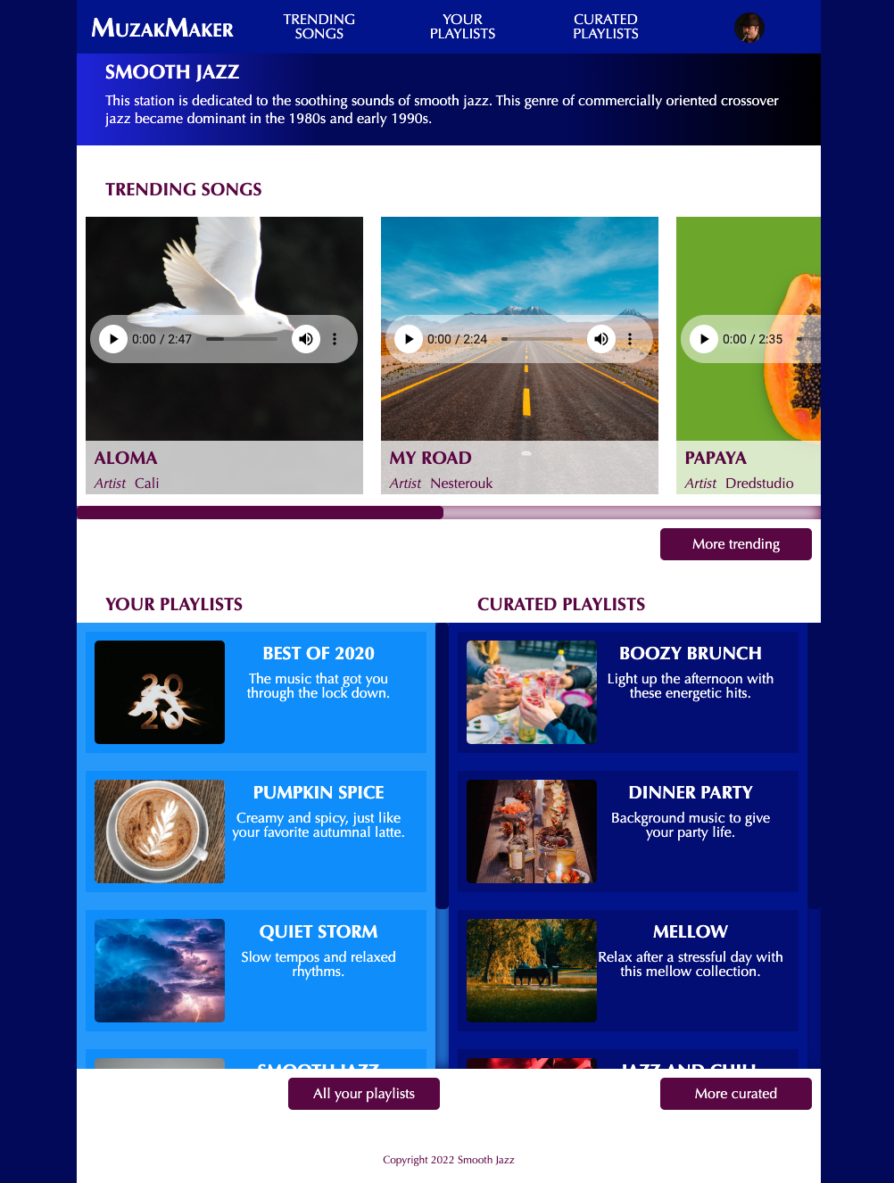
On hover, background-color changes to #590242
375px
834px
MuzakMaker is the first <li> in th <ul> and is styled differently than the others, small-caps
Hamburger menu uses an input checkbox to reveal the whole nav ul
See video & code provided with Content folder in Google Drive
The navigation expands to see all the links which start out hidden by the hamburger menu.
Scrolls to reveal 5 songs
Custom audio player See video & code provided with Content folder in Google Drive
Custom slider See video & code provided with Content folder in Google Drive
html background-color is #020659
And body is set to margin:0 auto to display in the center of the viewport window
Moves from the left to the right
Scrolls to reveal 5 playlists
Changes from vertical to horizontal
using only css, no new images
Custom slider
Scrolls to reveal 5 playlists
Changes from vertical to horizontal
using only css, no new images
Custom slider
On hover, background-color changes to #020659

